Slide 1
PREDICTIVE MODELING ON CUSTOMER BOOKING DATA
Submitted by:
Shweta Jain

Slide 2
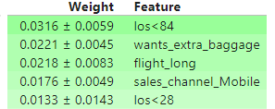
BEST MODEL: Random Forest Classifier
HYPERPARAMETER TUNING: Done
CLASS IMBALANCE: Handled with SMOTE
ROC-AUC SCORE ON TEST DATA: 0.56
Conclusion: More data needed to improve metric score
FEATURE IMPORTANCE:
Conclusion: Length of stay up to 84 days, Extra baggage requirement, Long Length of flight, Mobile as Sales channel found to be most important

